Slide 1
Segmentation Update
Nick Trajkovski

Slide 2
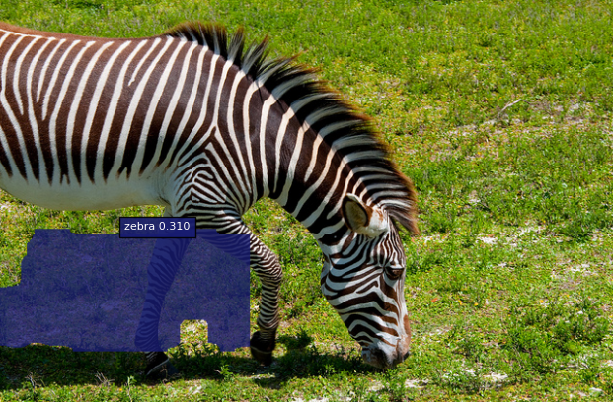
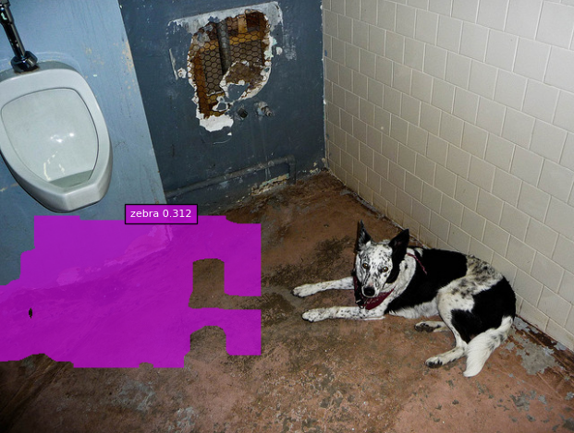
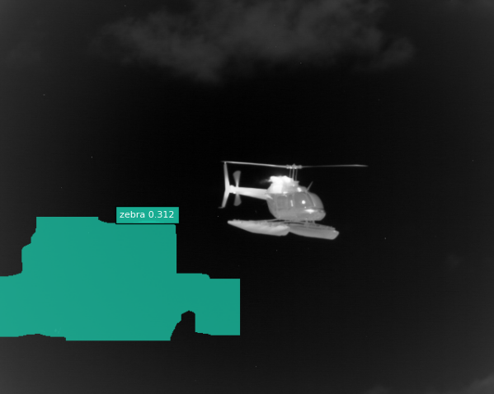
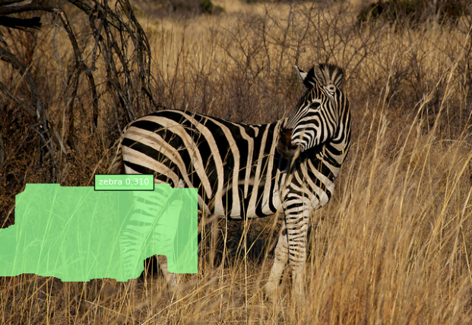
FCIS
Training does not segment properly
No response from developers

Slide 3
Other Segmentation Methods
A Review on Deep Learning Techniques Applied to Semantic Segmentation: 22 Apr 2017
Terminology / Concepts
Deep Network Architectures
Datasets & Challenges
Segmentation Methods
Methods & Network Comparisson

Slide 4
Semantic Segmentation Methods

Slide 5
Methods Compared

Slide 6
DeepLab
Uses Fully Connected Pairwise Conditional Random Fields (CRF) for postprocessing
Models each pixel as a node in the field and applies one pairwise term for each pair of pixels
Allows for pixel to pixel scores
Allows for global spatial awareness
Helps with capturing local detail
Able to recover detailed structures in the segmentation that were lost due to the spatial invariance of the CNN

Slide 7
DeepLab
TensorFlow implementation
Implemented: atrous (dilated) convolutions, atrous spatial pyramid pooling
Not implemented: multi-scale inputs (not implemented here), some CRF features
Caffe implementation by authors
Currently training PRISM with TensorFlow
Will attempt to setup Caffe implementation

Slide 8
Detectron
Facebook’s Segmentation Algorithm
Open Sourced 2 weeks ago: https://github.com/facebookresearch/Detectron
Implemented Algorithms: Mask R-CNN, RetinaNet, Faster R-CNN, RPN, Fast R-CNN, R-FCN
Implemented Network Architectures: ResNeXt{50,101,152}, ResNet{50,101,152}, Feature Pyramid Networks (with ResNet/ResNeXt), VGG16
Extenssible

Slide 9
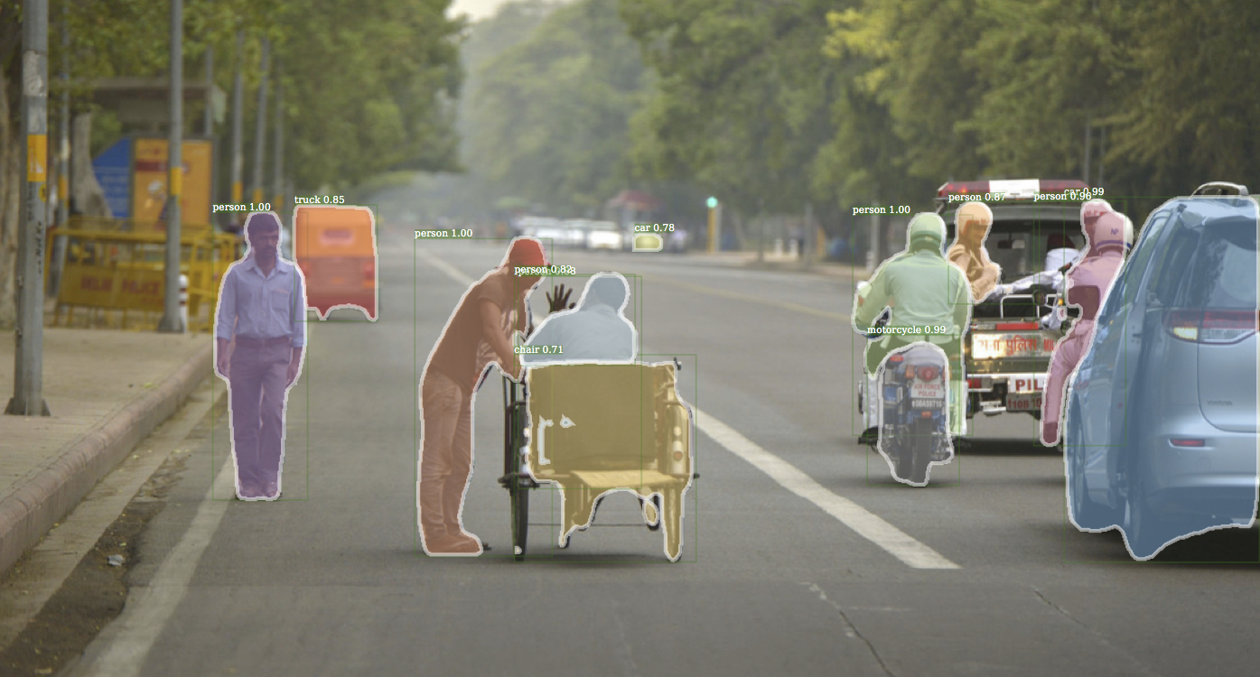
Detectron

Slide 10
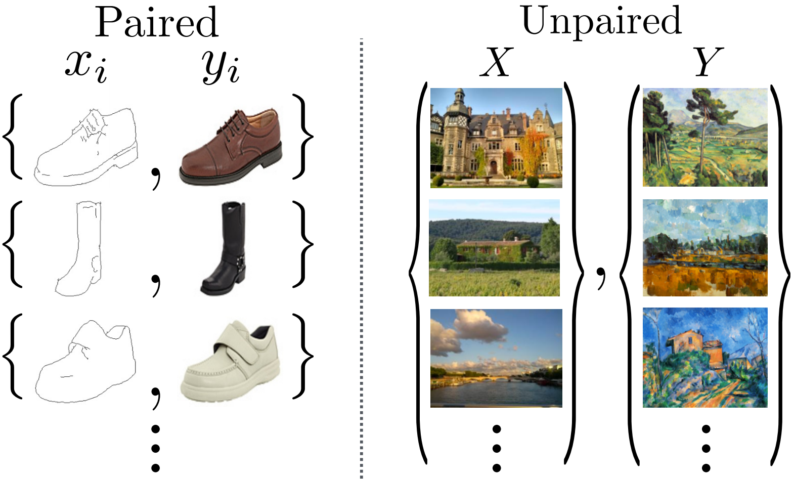
Unpaired Image-to-Image Translation using Cycle-Consistent Adversarial Networks: 24 Nov 2017
https://junyanz.github.io/CycleGAN/
Based on pix2pix
Doesn’t need paired image -> label training set
Can help with the lack of ground truths
Official Implementations: Torch, PyTorch
Unofficial Implementation: TensorFlow

Slide 11
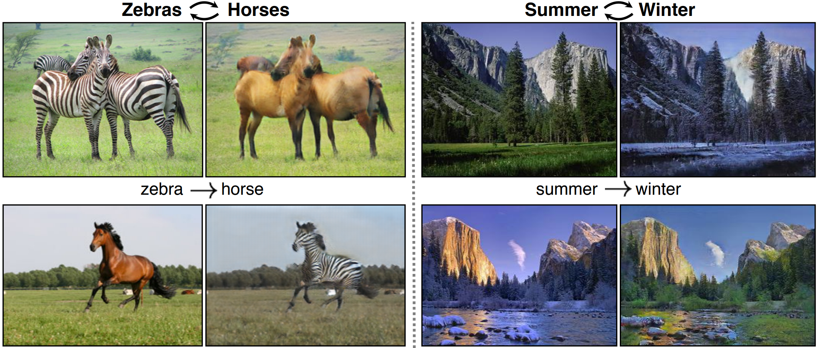

Slide 12


DeepLab Results: 150000 steps
Tested with default settings
Tested with settings from pix2pix

Slide 13
TensorFlow pix2pix
Created a guide of changes made to Torch version
Running test training right now
Next step: integrate Torch changes to TensorFlow version

